Slide 1
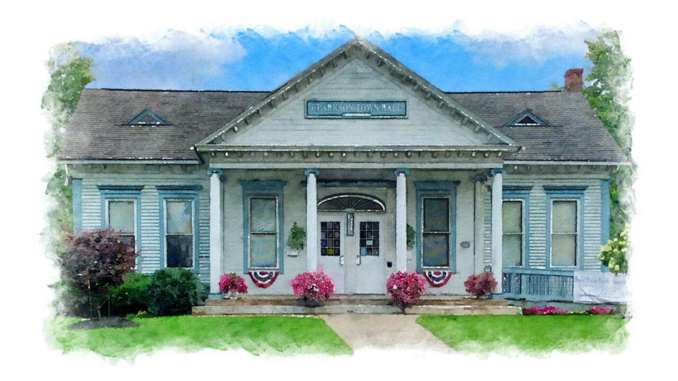
Town of Clarkson
2026 reassessment
Informational meeting
February 5, 2026
Meeting Location: Clarkson Town Court Office, 3665 Lake Road, Clarkson, NY 14430

Slide 2

AGENDA
Introduction: Tammy J. Baker, IAO
Professional Assessor
I have with me Leslie Burger and Jennifer Lis, Department of Finance and Taxation, Office of Real Property Services, Liaisons

Slide 3

The main purpose for a reassessment to establish and maintain equitable property assessments – ensure fair and uniform assessments of all real property

Slide 4

What a reassessment does
Produces equity by eliminating unfair assessments.
Properties are assessed at a uniform percentage of value
Distribute the tax burden fairly within a taxing jurisdiction.
Properties with similar values pay similar taxes within each taxing jurisdiction.
Property owners pay their fair share of the tax levies set by the Town, County,
Fire District and School district
Provides defensible data and assessments.

Slide 5

What a reassessment does not do
Reassessments do NOT generate additional tax revenue.
Tax levies are set by the County Legislature, Town Board, School Boards (The Town of Clarkson has 4 different School Districts – Brockport, Hilton, Holley and Kendall) and Fire Districts (There are 3 different fire districts, Clarkson/Brockport, Hamlin Morton Walker and Hilton-Parma)

Slide 6

What does it mean when the equalization rate decreases?
A falling equalization rate means that market values are rising faster than the assessed value. This is applied to Residential properties, vacant land and commercial properties.
The amount of an owner’s exemption is reduced by the decrease in the equalization rate. This includes the STAR Exemption and The STAR Credit.
Keeping assessments up-to-date can result in consistent equalization rates each year and ensure owners receive the full value of their exemptions. It also helps with special franchise values and Utility values, which are established by the state. Another reasoning is that it helps defend commercial valuation.

Slide 7
The down side of not staying at 100% equalization rate
Impacts on Exemptions
STAR EXEMPTION | BASIC | ENHANCED | WAR TIME VETERANS EXEMPTION | COMBAT VETERANS EXEMPTION
Was | $ 28,800 | $ 82,660 | $ 34,560 | $ 23,040
Will go to 84% | $ 25,200 | $ 74,340 | $ 30,240 | $ 20,160
STAR CHECK
Was | $ 534 | $ 1,495
Will go to 84% Estimate based on Potential school tax rate: | $ 495 | $ 1,468
At 100% equalization rate (Star amounts could be higher based on the increase in level of Assessment) | $ 30,000 | $ 88,500 | $ 36,000 | $ 24,000

Slide 8
Town of Clarkson 2026
Assessments vs. Taxes: What’s the difference?
Your assessment could increase, and your tax bill decrease
Your assessment could increase, and your tax bill decrease
Last Year | This Year
Your assessment: $ 213,500 | Your Assessment (30% ): $ 277,500
Total value of the town: $ 542,000,000 | Total value of the town: $713,000,000
Tax town levy: $ 1,500,000 | Tax Levy: $ 1,500,000
Tax Rate: $ 2.78 Per $1,000 | Tax Rate: $2.10 Per $1,000
Your town property tax bill: $ 593 | Your property tax bill: $ 582 ($11 Decrease)
Your assessment could increase, and your tax bill could stay the same
Last Year | This Year
Your assessment: $ 213,500 | Your Assessment (30% ): $ 277,500
Total value of the town: $ 542,000,000 | Total value of the town: $ 713,000,000
Tax levy: $ 1,500,000 | Tax levy: (2% increase) $ 1,530,000
Tax rate: $2.78 Per $1,000 | Tax rate $ 2.14 per $1,000
Your town property tax bill: $ 593 | Your property tax bill: $ 593
Without doing are-assessment, your tax bill could increase
Last Year | This Year
Your assessment $ 213,500 | Your Assessment : $ 213,500
Total value of the town: $ 542,000,000 | Total value of the town: $ 540,000,000
Tax levy: $ 1,500,000 | Tax levy: (2% increase): $ 1,530,000
Tax rate: $2.78 Per $1,000 | Tax rate: $ 2.83 Per $1,000
Your town property tax bill: $ 593 | Your property tax bill: $ 604 (increase $11)

Slide 9
The valid sales throughout the town
Type of house | Number of Sales | Median Sale Price | MEDIAN ASSESSED VALUE AT TIME OF SALE | MEAN SALE PRICE | MEAN ASSESSED VALUE | MAXIMUM SALE PRICE
RANCHES | 41 | $ 228,100 | $ 193,300 | $ 256,997 | $ 215,517 | $ 570,000
RAISED RANCHES | 11 | $ 245,000 | $ 200,400 | $ 237,945 | $ 200,691 | $ 325,000
SPLIT LEVELS | 9 | $ 225,000 | $ 195,000 | $ 240,333 | $ 201,811 | $ 320,000
CAPE COD | 15 | $ 275,000 | $ 248,300 | $ 308,400 | $ 260,073 | $ 525,995
COLONIAL | 58 | $ 278,150 | $ 215,000 | $ 302,992 | $ 264,895 | $ 575,000
OLD STYLE BUILT PRIOR TO 1950 | 26 | $ 247,500 | $215,000 | $ 269,828 | $ 253,277 | $ 705,000
TOWN HOUSE | 5 | $ 275,000 | $ 181,000 | $ 289,560 | $186,960 | $ 349,900
VACANT LAND SALES | 30 | $ 52,500 | $ 39,800 | $ 95,994 | $ 103,433 | $ 302,500
The sales are from 2022 - 2025

Slide 10
change of assessment notices will go out in March at which time you will be able to schedule an informal meeting with the assessor.
The assistant to the assessor Darla Emmerson will schedule your appointment.
(585) 637-8683
There will be a sales book available to review at the town hall
Q&A SESSIONS

Slide 11

Resources: www.tax.ny.gov/research/property/assess/tools.htm
Fair assessments: a guide for property owners reassessments: questions and answers how estimates of market value are determined for residential properties

Slide 12

THANK YOU
Tammy Baker, IAO, Professional Assessor
Assessors Office (585) 637-8683
Department of Taxation and Finance Office of Real Property Liaisons: Leslie Burger and Jennifer Lis

